Slide 1
Statistics and Reliability: Module 6
Hypothesis Testing
Notes:
Module Topics
Tests for means, variances, and proportions
Paired-comparison tests
Chi square
Copyright (c) Deere & Company, as an unpublished work. This material is the property of Deere & Company. All use, disclosure, and/or reproduction not specifically authorized by Deere & Company is prohibited.

Slide 2
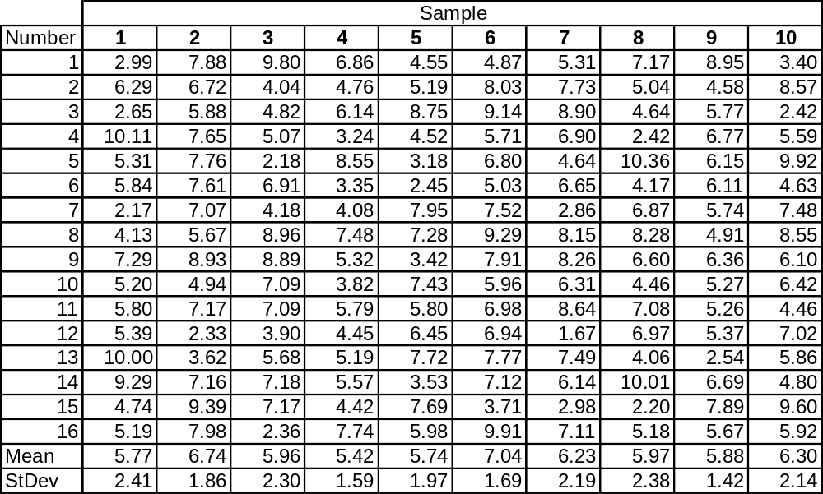
Table 3.3 Ten Random Samplings from a Normal PDF Where μ = 6 and σ = 2
Notes:
Here’s a data set we looked at numerically in Module 2 and graphically in Module 3. Now let’s look at it statistically. We’ll focus on Sample 1.

Slide 3
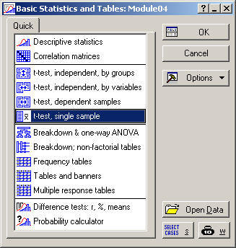
Notes:
Statistics > Basic Statistics/Tables > t-test, single sample

Slide 4
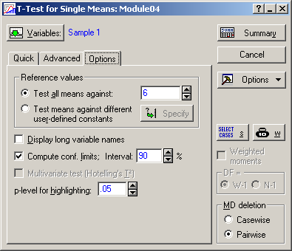

Notes:
Double-Sided Scenario: Unknown σ
Test all means against = 6
Compute conf. limits; Interval = 90
Compare to Double-Sided Scenarios and One-Sample T: Sampling 1 on page 412.
4.72 < μ < 6.83 with 90% confidence
The hypothesized value of 6 is contained within the confidence interval, so there is not sufficient evidence to reject the null hypothesis that the mean is equal to 6.

Slide 5


Notes:
Single-Sided Scenario: Unknown σ
Test all means against = 6
Compute conf. limits; Interval = 80 (90% one-sided)
Compare to Single-Sided Scenarios on page 412.
> 4.96 with 90% confidence
There is insufficient evidence to reject the hypothesis that the is less than or equal to 6.
< 6.58 with 90% confidence
There is insufficient evidence to reject the hypothesis that the is greater than or equal to 6.

Slide 6
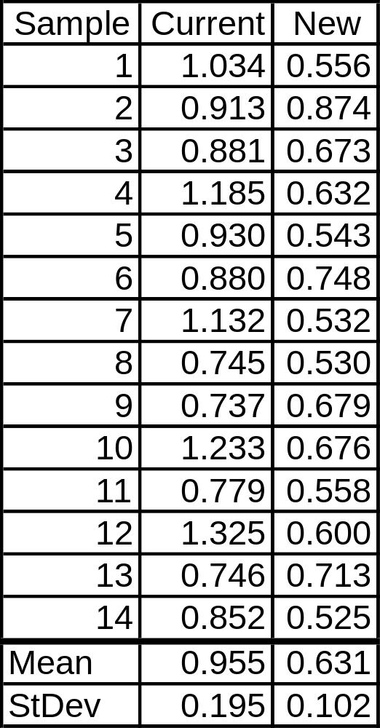
19.5 Example 19.1: Comparing the Means of Two Samples
Notes:
Recall that we looked at this data graphically in Module 3.
Page 439: “Over 20 changes were considered in multiple DOEs, but only three design changes were found beneficial. A comparison experiment was conducted to confirm and quantify the benefit of these three design changes. The results from the test were as follows (a lower number indicates that a machine has better voice quality).”
VQM = Voice Quality Measure of a portable dictating machine

Slide 7
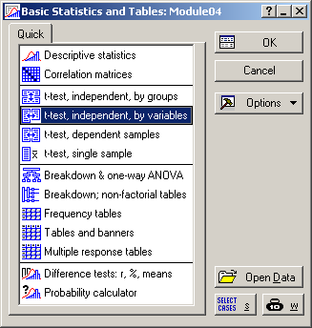
Notes:
Statistics > Basic Statistics/Tables > t-test, independent, by variables

Slide 8
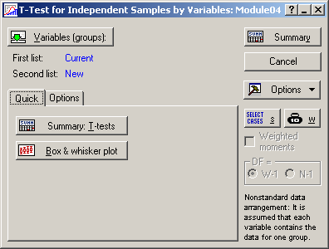

Notes:
Select variables:
First list = Current
Second list = New
Compare to results to those listed on page 440. The p-value = 0.000009 is so low that there very little chance that these means are the same.
Also compare the “F-ratio Variance” to the results listed on page 441. Since the assumption of equal variances is not true (p-value = 0.027), you should use the other form of the 2-sample t-test that doesn’t make this assumption (see the Options tab). But when you do, you get the same answer. The means are so different that it doesn’t matter, which we saw graphically in Module 3.

Slide 9
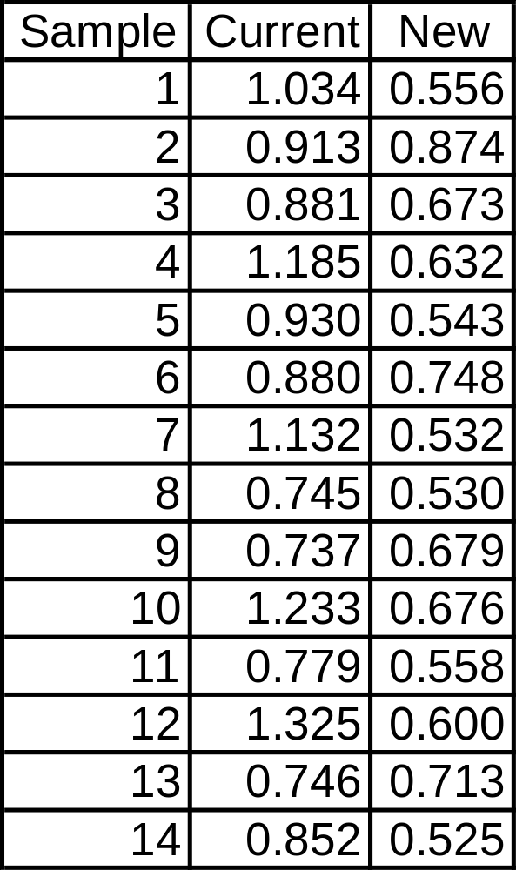
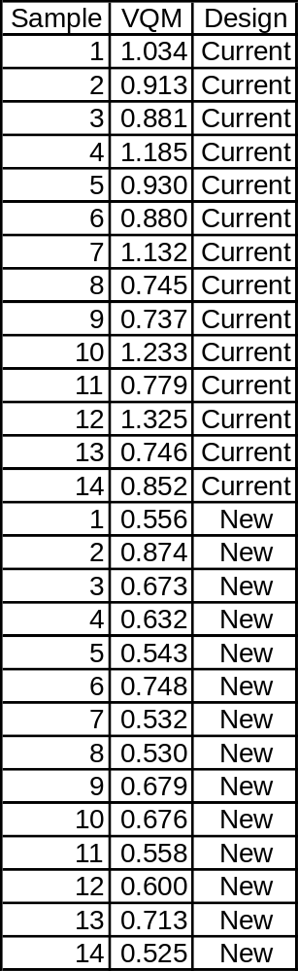
19.5 Example 19.1: Comparing the Means of Two Samples
Notes:
Or we could look at the data with the VQM values in one column and the Design ID in another.
VQM = Voice Quality Measure of a portable dictating machine

Slide 10
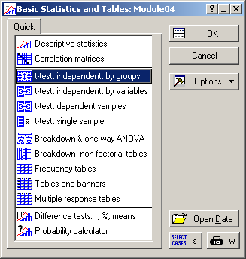
Notes:
Statistics > Basic Statistics/Tables > t-test, independent, by groups

Slide 11
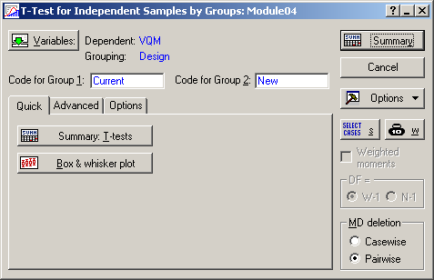
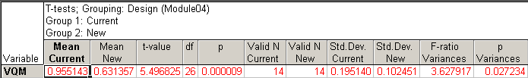
Notes:
Select variables:
Dependent = VQM
Grouping = Design
The results are the same, just the data format is different. This format has the advantage that we can make categorized graphs like we did in Module 3.

Slide 12
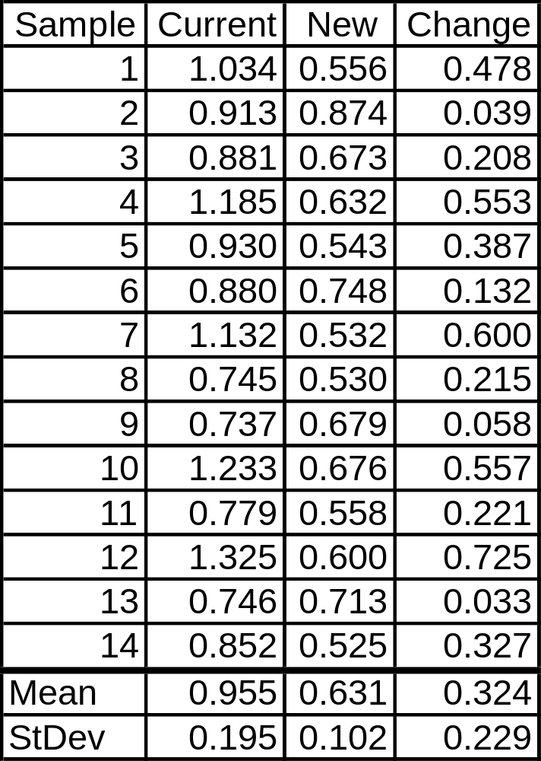
19.11 Example 19.4: Paired Comparison Testing
Notes:
Now, instead of comparing the mean and standard deviations of the Current and New designs, we will look at the mean and standard deviation of the Change from Current to New.
This can occur when the data comes in pairs. For example 14 different portable dictating machines were used in this experiment, not 28. The current design was used in the 14 devices, and then the new design was used in the same devices. For example, the software could have been switched.
By looking at the change, we can block out differences due to the test specimens – the 14 different portable dictating machines in this case – and know that the changes were due just to the current and new designs.

Slide 13
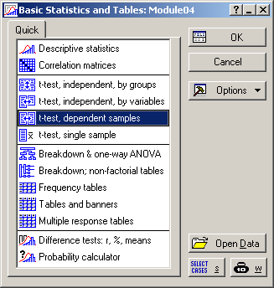
Notes:
Statistics > Basic Statistics/Tables > t-test, dependent samples

Slide 14
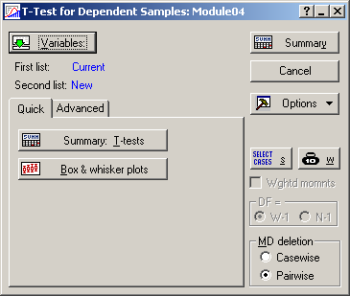
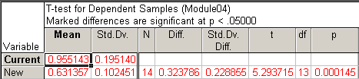
Notes:
Select the Variables:
First list = Current
Second list = New
Click “Summary: T-test” or just “Summary” in the upper right-hand corner
The results are shown in the table below the menu. The p-value is very small, so there is strong evidence that the means are not equal.

Slide 15
Notes:
Statistics > Basic Statistics/Tables > t-test, single sample

Slide 16
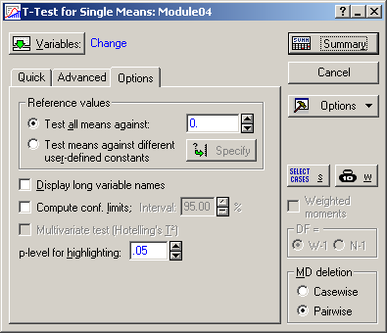

Notes:
Select the Variables = Change
Click “Summary” in the upper right-hand corner
The results are shown in the table below the menu. The p-value is very small (the same value as before), so there is strong evidence that the means are not equal.

Slide 17
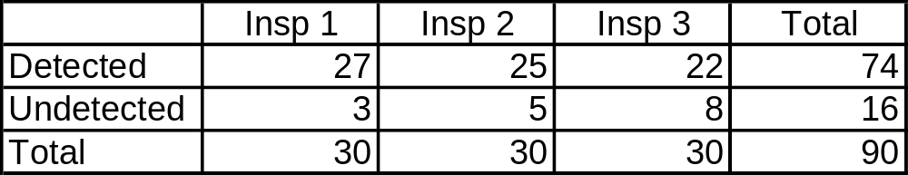
20.5 Example 20.1: Comparing Proportions
Notes:
Page 457: “The abilities of three x-ray inspectors at an airport were evaluated on the detection of key items. A test was devised in which 90 pieces of luggage were ‘bugged’ with a device that they should question. Each inspector was exposed to exactly 30 of the ‘bugged’ items in random fashion. The hull hypothesis is that there is no difference between inspectors. The alternative hypothesis that at least one of the proportions is different.
Reformat data from a 2x3 table to 2 columns of 90 observations – Statistica can only analyze the raw data, not the summarized data.

Slide 18
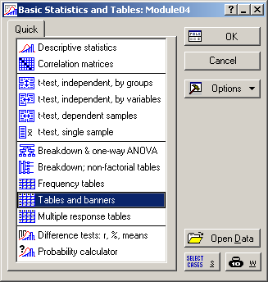
Notes:
Statistics > Basic Statistics/Tables > Tables and banners

Slide 19
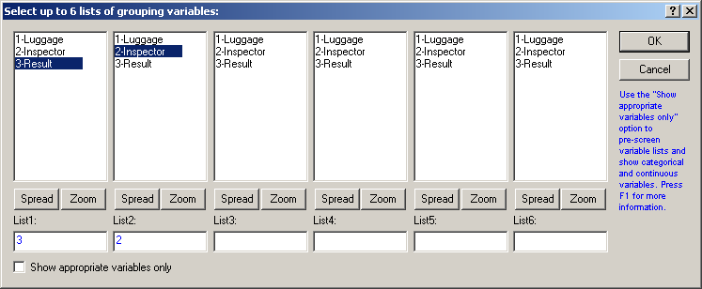
Notes:
List1 = 3 (Results)
List2 = 2 (Inspector)
The order is not important; it just affects the layout of the table. This order was chosen so the table matches the layout in the textbook.

Slide 20
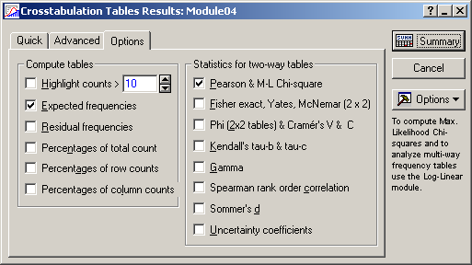
Notes:
Uncheck “Highlight counts >” – no need for that.
Check “Expected frequencies”
Check “Pearson & M-L Chi-square”
Click on “Summary”

Slide 21
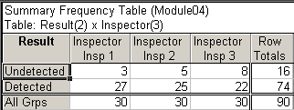
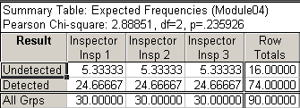
Notes:
Compare to table on page 458.
The p-value = 0.24 (0.235926) indicates there is insufficient evidence to declare a difference.

Slide 22
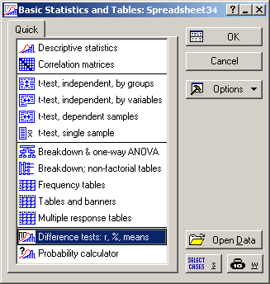
Notes:
Statistics > Basic Statistics/Tables > Difference tests: r, %, means

Slide 23
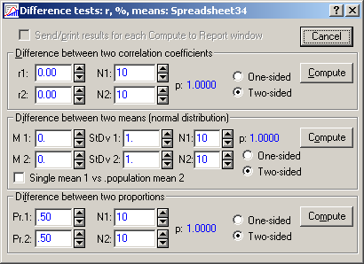
Notes:
This menu is good if you only have summary data, not the raw data.
I tried the 3rd option with Example 20.4: Difference in Two Proportions on page 461, but it didn’t work.

